Slide 1

Aid Escalating Internet Coverage
Team- Zero Accuracy
Prasad Magdum (MT2022078) Prateek Chhimwal (MT2022080)

Slide 2
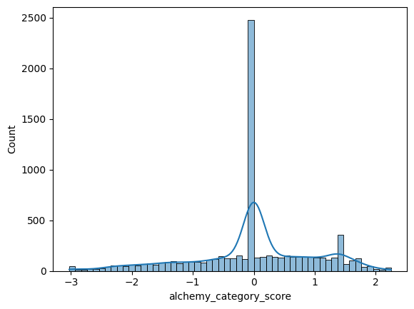
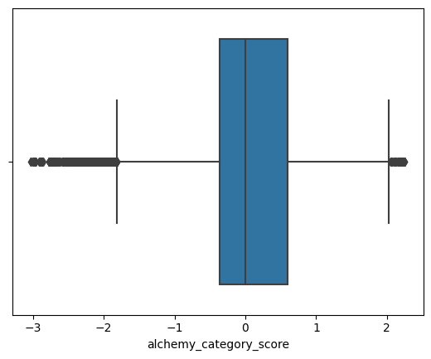
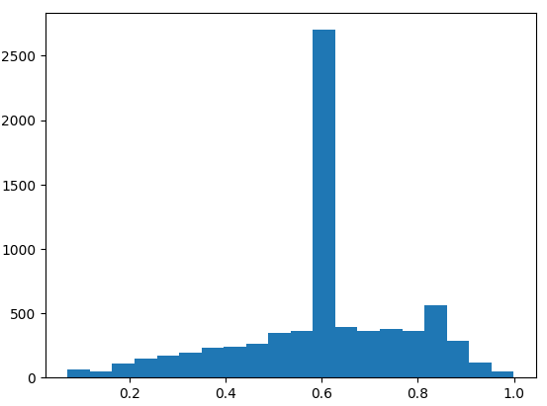
Exploratory Data Analysis
Standardization | Outlier Removal | Skewness
We have standardized all the columns in the dataset. | If the data point lies beyond upper whisker and lower whisker we brought them between lower whisker and upper whisker. | To check whether the data is significantly skewed or not.

Slide 3
Data Preprocessing
Checked for NULL? | Checked Missing Values? | Checked for Duplicate values? | Datatype | Dropped columns
No NULL values. | Present in the dataset. | No duplicate values. | Converted OBJECT to NUMERIC datatype. | frame_based (All zeros) is_news(? or 1)
Handling missing values
alchemy_category- Replaced “?” with (Mode=recreation).
alchemy_category_score- Replaced “?” with Mean value.

Slide 4
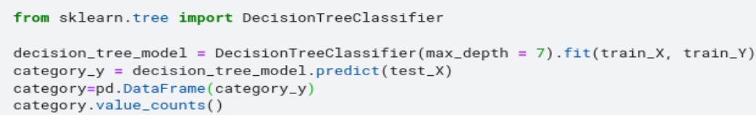
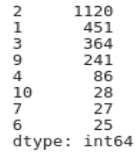
Data Preprocessing (Continued)
PREDICTION OF “alchemy_category” | PREDICTION OF “alchemy_category_score”
Data corresponding to “?” put into test dataset. Remaining data taken as train dataset. Applied Decision Tree algorithm to do multiclass classification. Replaced “?” with the corressponding predicted values. | The data corresponding to “?” is put into test dataset. Remaining data is taken as train dataset. Predicting “alchemy_category_score” value using Linear Regression algorithm.

Slide 5
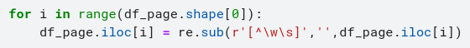
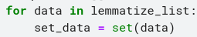
Natural Language Processing (Cleaning on ”page_description” column)
Text Preprocessing
Tokenization
Stop word removal
Lemmatization
Select unique values

Slide 6
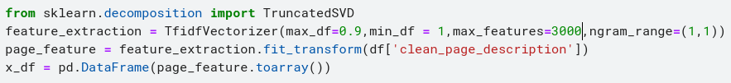
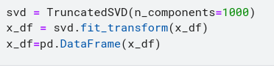
Natural Language Processing (Word Embedding using TF-IDF)
Used TF-IDF vectorizer to transform the text in the “page_description” column into usable vector
Dimensionality reduction using single value decomposition

Slide 7
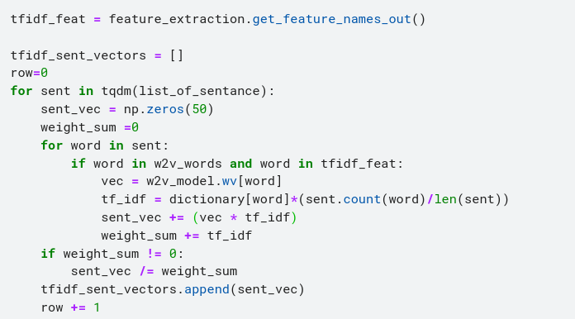
Natural Language Processing (Word Embedding using Word2Vec)
TFIDF weighted Word2Vec
Calculated TF-IDF value of each word and then by multiplying TF-IDF value with the corresponding word & then divided the sum by TF-IDF value’s sum.

Slide 8
Training
Used following models for training-
1. Logistic Regression- max_iter=700
2. XG-Boost- Randomized Search
3. K-Nearest Neighbors- Randomized Search
4. Support Vector Machine- Radial Basis Kernel
5. Voting Ensemble- Logistic Regression,SVM,Decision Tree with Soft Voting

Slide 9
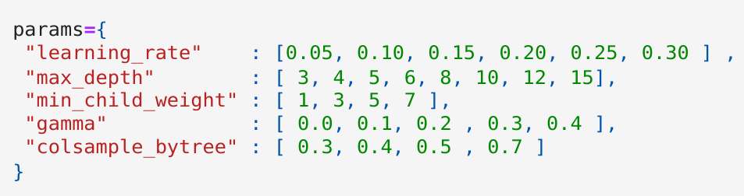
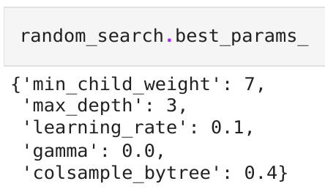
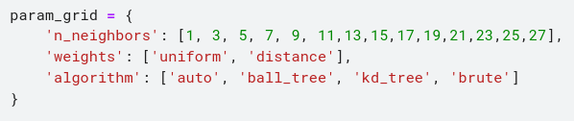
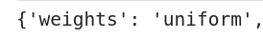
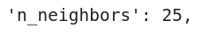
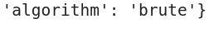
Training (Hyperparameter Tuning for XG-Boost and Random Forest)
XG-Boost
K-Nearest Neighbor

Slide 10
Validation (‘auc_roc’ score)
Logistic Regression | 0.8762
XG-Boost | 0.8629
K-Nearest Neighbor | 0.8604
Support Vector Machine | 0.8580
Voting Ensemble | 0.8536

Slide 11
Testing (‘auc_roc’ score)
Logistic Regression | 0.8816
XG-Boost | 0.8722
K-Nearest Neighbor | 0.8662
Support Vector Machine | 0.8694
Voting Ensemble | 0.8728

Slide 12
Contributions by Team Members
Prasad Magdum (MT2022078)
Performed data preprocessing by checking for null, missing (“?”) & duplicate value, converted categorical data to numeric data, dropped columns with irrelevant information.
Inorder to make our model more robust, in data preprocessing predicted “alchemy_category” using decision tree classifier & “alchemy_category score” using linear regression.
Used TD-IDF weighted Word2Vec by calculating TF-IDF value of each word and then by multiplying TF-IDF value with the corresponding word & then divided the sum by TF-IDF value’s sum.
Applied Logistic Regression, XG-Boost with randomized search to train our model on the training data set and predicted “Ad-worthy” or “NOT Ad-worthy” probabilty values.
Prateek Chhimwal (MT2022080)
To expose trends, relationships, and patterns that were not readily apparent through exploratory data analysis involving checking for skewness in the features, standardizing the data, removing outlier from the dataset.
Applied text preprocessing on the “page_description” column removing symbols, numerals etc, tokenization, removed stop-words, lemmatization & selected only unique words.
Used TF-IDF vectorizer to convert textual data to vector to be used as an input for our training model.
Applied Support vector machine, Voting ensemble (Logistic Regression, SVM, Decison Tree) with Soft Voting to train our model on the training data set and predicted “Ad-worthy” or “NOT Ad-worthy” probabilty values.

